Slide 1
WIRELESS SECURITY 802.11
Submitted By: Ginalford Marwein @ Apki Lyngdoh
MCA 4th Semester
St. Anthony’s College, Shillong.

Slide 2
Contents
Abstract
Basic Wireless LAN Concepts
IEEE 802.11 Security
Access Control List
WEP(Wired Equivalent Privacy)
WEP Key Recovery
IVCollision
Dynamic WEP
WPA(WI-FI Protected Access)
TKIP(Temporal Key Integrity Protocol)
MIC(Message Integrity Code)
WPA-PSK (WPA Pre-Shared Key)
802.11i
AES-CCMP (Advanced Encryption Standard – Counter mode CBC MAC Protocol)
Wireless Networks Tools
MAC spoofing
Wireless Analysers
WEP Cracking Tools

Slide 3
Abstract
The 802.11 wireless networks is one of the most attractive and fast growing networks. Because of its easy and fast deployment and installation, there are more and more users considering using this type of network than the wired version.

Slide 4
How to secure an 802.11 wireless network
By understanding its security protocols and mechanism.
Security protocols such as WEP, WPA and 802.11i, and mechanisms such as MAC access control list; their vulnerabilities and tools available to exploit these vulnerabilities.

Slide 5
Basic Wireless LAN Concepts
The IEEE 802.11 is a family of standards, each one defining and specifying parts of the standard. Some of these standards are:
Physical and Max data rate specification
802.11b, using the 2.4 GHz radio spectrum and 11 Mbps max data rate.
802.11a, using the 5 GHz radio spectrum and 54 Mbps max data rate.
802.11g, using the 2.4 GHz radio spectrum and 54 Mbps max data rate.
Security
This standard defines the 802.11
wireless network security protocols.

Slide 6
QoS (Quality of Service)
802.11e Quality of Service in 802.11 wireless networks. This standard defines the QoS for traffic prioritization to give delay sensitive application such as multimedia and voice communication priority.
The 802.11 wireless networks operate in two basic modes: infrastructure and ad-hoc
Infrastructure: each wireless client connects directly to a central device called Access Point; there is no direct connection between others wireless clients. An Access Point acts as a wireless hub that connects the wired network with the wireless clients and handles the connections between them.
Ad-hoc: each wireless client connects directly with each other. There is no central device managing the connections, meaning that each wireless client talks to each other freely. The main advantage of this operation mode is that it permits a rapid deployment of a temporal network where no infrastructures exist

Slide 7
IEEE 802.11 Security
Access Control List
The access control list is the simplest security measure we can find in a wireless network.
The protection offered by this mechanism mainly consists of filtering out unknown users and requires a list of authorized client’s MAC addresses to be loaded in the Access Point.
Only those registered MAC addresses will be able to communicate with the Access Point, and will drop any communication that come from others not registered MAC addresses.
As the name implies, it just offers access control to the network behind the access point, no any other protection are offered. Therefore, any wireless network protected with only this mechanism is very vulnerable and open to any network attack.

Slide 8
WEP (Wired Equivalent Privacy)
WEP (Wired Equivalent Privacy) was the only link-level security option defined in the 802.11 standard.
Its main purpose was the protection of the confidentiality and integrity of the wireless network traffic. WEP was designed to provide comparable confidentiality to a traditional wired network.
To meet the security proposed, WEP uses encryption to protect the data. It uses a 64 or 128 bits key to encrypt the data.
WEP uses the RC4 stream cipher with a 64 or 128 bits key to provide data packet encryption.
In a WEP-protected wireless network, every member of this wireless network, the wireless clients, must share the same secret key with the Access Point.
This secret key can be a password or a character sequence generated by a wireless configuration program using a passphrase.

Slide 9
In a WEP-protected wireless network, a data packet that gets into the link-level is encrypted before sending it off the air. The data packet encryption is performed as follow:
First, the wireless network interface randomly chooses an IV value and concatenated with the shared secret key to form the WEP Key (IV + secret key).
When the WEP Key is ready, this key is passed to the RC4 stream cipher to produce a pseudo-random string with the data packet length.
it then performs a logical XOR operation between the data package with the pseudo-random string.
To complete the WEP-protected data packet, the link-level headers, IV value and the encrypted data packet are packed together and then transmitted to the recipient

Slide 10
The steps for encrypting messages are also the same steps for decrypting a WEP-protected data packet.
When the recipient decrypts a WEP-protected data packet, it first reads the IV value and then follows the same steps of the encryption process.
Finally, the data is decrypted by performing a second logical XOR operation between the encrypted data packet with pseudo-random string, canceling the effect of the first logical XOR operation.

Slide 11
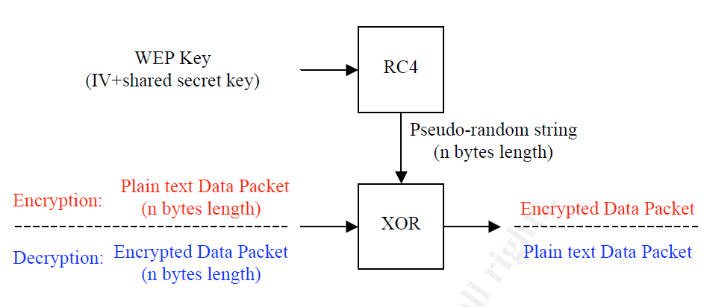
Fig: WEP Encryption/Decryption Process

Slide 12
WEP Key recovery
The WEP protocol contains a critical cryptographic weakness that allows an attacker to possible recover the shared secret key.
This weakness consists of exploiting the fact that certain IV value produces weak WEP keys.
When a weak WEP key is used to encrypt, the first bytes of the pseudo-random string may contain some correlation with the WEP key.
This weakness was publish by Fluhrer, Mantin,and Shamir, in “Weaknesses in the Key Scheduling Algorithm in RC4”.
Some of the first tools that exploit the FMS weakness are Airsnort8 and Wepcrack9.
There are also others tools that have more capabilities, including optimizations for requiring less weak WEP-protected data packets and brute-force attacks.
Such tools are: Airjack, dwepcrack, Aircrack. Generally, this tools works on a UNIX/Linux platform, but some tools are already ported to Windows OS.

Slide 13
IV collision
Another way for an attacker to break into a wireless network without knowing the shared secret key is by also capturing passively a large amount of data packets, but this time is looking for IV collision.
An IV collision occurs when two or more data packets are encrypted with the same IV value, therefore the same WEP key.
When an IV collision is detected, the attacker can perform a logic XOR with the two encrypted data packet to take off the encryption. The result is the XOR of the two data packets.
The data packet contents recovery effort and time required decreases when more packets encrypted with exactly the same WEP key are captured and used for the recovery.
Avoiding some IVs reduces the number of WEP keys making the IV collision weakness worse.

Slide 14
Dynamic WEP
Before an attacker can actually access to a WEP protected network, he needs to capture a large quantity of data packets to crack the shared secret key.
If the wireless network could change the shared secret key every time before the attacker could get enough data packets to crack the secret key, it will make it much harder to crack the secret key.
Therefore, a way to prevent a possible secret key recovery without making any other vulnerability worse is by changing the shared secret key frequently.
A solution to achieve this goal is using the 802.1x protocol to provide automatic key delivery and periodic rekeying.
The 802.1x protocol handles the user authentication and authorization process.
The authentication server generates the WEP key when a user is authenticated and authorized.

Slide 15
WPA (Wi-Fi Protected Access)
WPA is a solution released by the Wi Fi Alliance while a definitive security protocol is standardized.
This security protocol is based on 802.11i, the next 802.11 wireless network security protocol standard. WPA consists of three main components: TKIP, 802.1x, and MIC.
Each component was designed and implemented to address specifics 802.11 weakness.
Important security improvements were implemented, such as key hierarchy. Using key hierarchy means that WPA does not directly use the main key to encrypt, instead the main key is used to generate other temporal keys such as session keys, group keys, etc

Slide 16
TKIP(Temporal Key Integrity Protocol)
This protocol is the direct replacement of WEP and it addresses most critical vulnerability.
its designed goal was to maintain compatibility with existing 802.11 hardware so they could be upgraded via software.
One of the most important enhancement from WEP is that each packet is guaranteed to use a completely different key by generating it by a per-packet key mixing function instead of a concatenation of the IV and the shared secret key.

Slide 17
How does TKIP work? (Contd..)
Each packet’s key is generated by a per-packet key mixing function.
The per-packet key is generated by hashing the senders MAC address, the IV, and the session key.
the per-packet key mixing function is divided in two phases:
Phase 1: The senders MAC address, temporal session key, and the highest 32 bits of the initialization vector are hashed together. The result from this phase remains intact until a session key change occur or each time the IV upper 32 bits change.
Phase 2: This phase is calculated for each packet received. The lowest 16 bits and the result of the phase 1 are hashed together. The result of this phase is the 104 bits per-packet key.
Using TKIP, it effectively improving the wireless network security.

Slide 18
MIC(Message Integrity Code)
MIC is a keyed hashing function that protects the data packet integrity.
This is an 8-byte value, which is calculated across the entire unencrypted raw data packet before being encrypted and transmitted.
The main purpose is to detect any kind of bad intentioned packet modification.
The hashing function used by MIC is a new hashing function specially designed for low processing power devices, such as the hardware in the wireless network interface.
When the wireless network detects an altered data packet, it will trigger the countermeasures, which are the following:
The wireless link of the compromised devices are disabled for 60 seconds, and
Every compromised device is forced to request new session keys.

Slide 19
WPA-PSK (WPA Pre-Shared Key)
WPA offers a special mode where there is no 802.1x authentication infrastructure, permitting the use of a pass phrase as a pre-shared key.
Every station may have its own pre-shared key tied to its MAC address, but most of the manufacturers implement only one pre-shared key for the whole wireless network.
A weakness has already been found on this WPA operation mode. If the pre-shared key is configured with a weak pass phrase, an attacker can capture the authentication messages and then made an offline recovery of the passphrase.
Users using WPA-PSK are encouraged to use complex and long passphrase to prevent the passphrase to be cracked.

Slide 20
802.11i
WPA is a subset of the new security standard 802.11i (a.k.a. WPA2), meaning that 802.11i includes all WPA capabilities features and more security features.
The main difference between 802.11i and WPA is the ability of 802.11i to use state-of-the-art AES (Advanced Encryption Standard) to encrypt the data packets.
The AES algorithm is the encryption standard used by U.S government agency10.
using AES encryption is that WEP only capable wireless network interface cannot be software upgraded to support AES.

Slide 21
AES-CCMP (Advanced Encryption Standard – Counter mode CBC MAC Protocol)
The 802.11i standard can use the AES (Advanced Encryption Standard) block cipher to encrypt the data packets, which replaces the WEP’s RC4 stream cipher.
The AES encryption algorithm is a block cipher, which encrypts the data in blocks of fixed length. For 802.11i, the block size as well as the per-packet key size is 128-bit.
Block ciphers have several mode of operation
The mode of operation selected by 802.11i is CCMP (Counter mode with Cipher Block Chaining Message Authentication Code). This mode of operation offers counter mode for protecting privacy while Cipher Block Chaining Message Authentication Code is used for protecting the data integrity.

Slide 22
In counter mode, each fixed size data block is not encrypted directly instead, a arbitrary value is encrypted and then combined with a logical XOR with a data block.
The Cipher Block Chaining Message Authentication Code creates a MIC to protect the data integrity.
To generate the MIC each encrypted data block is performed a logical XOR with the result of the previous MIC. The result is then encrypted with AES.
The process repeats until all the blocks for a message are processed. In this way, the data of all the blocks are combined in a single 128-bit block.

Slide 23
Wireless Networks Tools
MAC spoofing
SMAC
MAC Makeup
Wireless Analysers
Kismet Wireless
Airtraf
Netstumbler
WEP Cracking Tools
Airsnort
WEPAttack
WEPCrack
dwepcrack

Slide 24
References
http://overview_80211_wireless_network_security_standards_mechanisms_1530.htm

